Slide 1




NEXT GEN EMPLOYABILITY PROGRAM
Creating a future-ready workforce
Team Members
College Name
Student Name : Kavya shri.R
Student ID : au711021104023
Info Institute Of Engineering

Slide 2
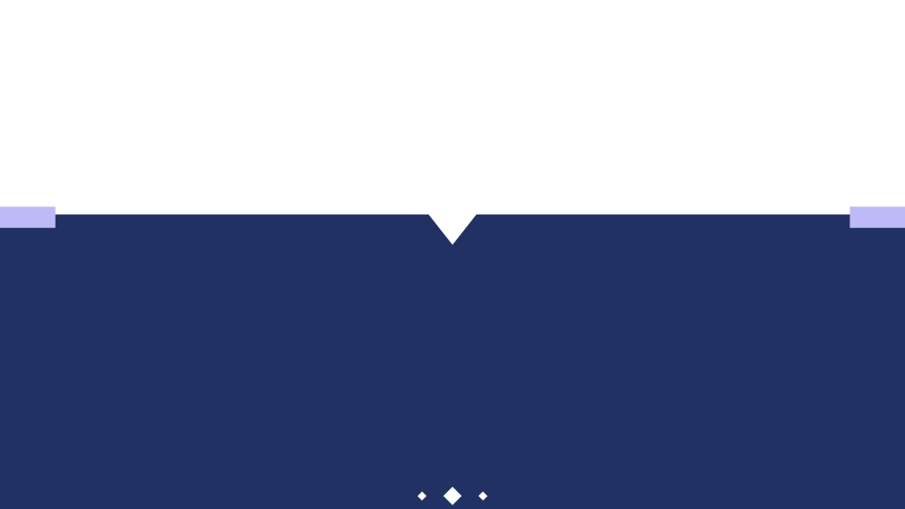
CAPSTONE PROJECT SHOWCASE
Project Title
Notes Sharing Web Application using Django Framework
Abstract | Problem Statement | Project Overview | Proposed Solution | Technology Used | Modelling & Results | Conclusion

Slide 3
Abstract
The proposed project aims to develop a notes-sharing web application using the Django framework. This application will allow users to create, edit, delete, and share notes with others in a collaborative environment. Users will be able to register an account, log in securely, and manage their notes with features such as categorization, tagging, and searching. Additionally, the application will incorporate authentication and authorization mechanisms to ensure data security and user privacy. Through this project, users will have a convenient platform for organizing and sharing their notes effectively.
Source :

Slide 4
Problem Statement
The existing methods for sharing notes often lack convenience, security, and collaboration features. There is a need for a modern, user-friendly solution that allows individuals to easily create, manage, and share notes with others in a secure online environment. The proposed notes-sharing web application using the Django framework aims to address these shortcomings by providing a platform where users can seamlessly collaborate, organize, and access their notes from any device. Key challenges to overcome include implementing robust authentication and authorization systems, designing an intuitive user interface, and ensuring data integrity and privacy. This project seeks to deliver a solution that meets the growing demand for efficient note-sharing tools while prioritizing usability, security, and scalability.
Source :

Slide 5
Project Overview
The notes-sharing web application project built on the Django framework aims to facilitate seamless collaboration and organization of notes among users. It provides a platform where registered users can securely create, edit, and share notes online. The application features user authentication for secure access, allowing users to register, log in, and log out. Users can create new notes, view a list of their existing notes, and edit them as needed. Additionally, the application enables users to share notes with other registered users, enhancing collaboration possibilities.With a technology stack comprising Django for the backend, SQLite for the database, and HTML, CSS, and JavaScript for the frontend, the application ensures a robust and user-friendly experience. Deployment considerations include options like Heroku, AWS, or DigitalOcean, with a focus on security, scalability, and documentation to support future improvements and enhancements.
Source :

Slide 6
Proposed Solution
.
The proposed solution involves developing a notes-sharing web application using the Django framework. Starting with project setup and database modeling, we'll define models for users and notes, incorporating authentication features and ensuring secure user access. Views and templates will be created for user authentication and note management, while a clean and responsive frontend will be designed using HTML, CSS, and possibly Bootstrap. CRUD operations will enable users to create, read, update, and delete their notes, with added functionality for sharing notes with others. Search capabilities will be implemented to allow users to find notes based on keywords or tags. Security measures will be put in place to protect user data and ensure proper permissions. Extensive testing will be conducted to ensure the application's functionality and reliability, followed by deployment to a hosting platform. Comprehensive documentation will guide users on using the application, with continuous feedback and iteration to improve its usability and features over time.
Source :

Slide 7
The initial phase of developing a notes-sharing web application using Django entails setting up the project environment and defining the database models. To begin, we'll establish a Django project within a virtual environment, ensuring a clean and isolated development environment. Then, we'll design database models to represent users, notes, and any other pertinent entities. The user model will facilitate authentication, enabling users to register, log in, and manage their accounts securely. Meanwhile, the note model will store essential information such as note content, ownership, timestamps, and sharing permissions. With these foundational components in place, we'll lay the groundwork for implementing authentication, authorization, and note management functionalities.
Source :

Slide 8
This phase encompasses several crucial steps, including authentication and authorization mechanisms, CRUD operations for notes, sharing functionality, search capabilities, security measures, testing, documentation, and deployment. We'll develop views, templates, and frontend components to create an intuitive user interface that facilitates seamless interaction with the application. Robust testing procedures will be employed to ensure the reliability and functionality of the application, covering unit tests, integration tests, and user acceptance tests. Once the application has been thoroughly tested and refined, we'll deploy it to a hosting provider such as Heroku or AWS, configuring the necessary settings for security, scalability, and performance. Comprehensive documentation will be provided to guide users on utilizing the application effectively, while continuous feedback and iteration will drive ongoing enhancements and optimizations to meet user needs and expectations.
Source :

Slide 9


Technology Used
Front-end
Back-end
Source :

Slide 10
Modelling & Results
A notes sharing web application built with Django framework would entail several key components in its modeling. The application would have a User model to handle user authentication and authorization, allowing users to sign up, log in, and manage their accounts. Additionally, there would be a Note model to represent individual notes, which would include fields for the title, content, timestamp, and possibly tags for categorization. Relationships between users and notes could be established through a ForeignKey or ManyToManyField, depending on whether notes are private or shared among multiple users. The application could also implement features such as search functionality, allowing users to find notes based on keywords or tags. In terms of results, such an application would provide a user-friendly interface for creating, viewing, editing, and deleting notes. Users would be able to easily share notes with others, collaborate on them, and organize their notes effectively. The application would facilitate efficient note-taking and sharing, enhancing productivity and collaboration among users.
Source :

Slide 11
Homepage

Slide 12
About-Us-Page

Slide 13
Service-Page

Slide 14
Departments-Page

Slide 15
Blog-Page

Slide 16
Future Enhancements
In the future, the notes sharing web application built on the Django framework could benefit from several enhancements to improve functionality and user experience.One potential enhancement is implementing real-time collaboration features, allowing multiple users to edit and view notes simultaneously.Integrating version control could also be valuable, enabling users to track changes made to notes and revert to previous versions if needed.Enhancing security measures, such as end-to-end encryption for sensitive notes and implementing two-factor authentication, would bolster the platform's trustworthiness.Furthermore, integrating with other productivity tools like calendars or task managers could offer users a seamless workflow.Overall, these future enhancements would elevate the notes sharing web application, making it more versatile, secure, and user-friendly for its audience.
.

Slide 17
Conclusion
In conclusion, a notes sharing web application developed with Django framework offers a robust solution for users to effectively manage and collaborate on their notes. By leveraging Django's built-in features for user authentication, data modeling, and web development, the application provides a seamless user experience. Users can securely create, edit, and share notes, facilitating collaboration and knowledge sharing.Overall, a Django-based notes sharing web application empowers users to streamline their note-taking process and enhance productivity through efficient collaboration and organization.
Source :

Slide 18
Thank You!
Notes:
Thank You !!

